Slide 1
M3P04 Project
Bird Classification Project

Slide 2
Summary
Objective: The goal is to build an image classification model with the best possible performance.
Dataset: 20 bird species, 3208 training images, 100 test images(5 images per species), 100 validation images (5 images per species).
Reference link for data set: https://www.kaggle.com/datasets/umairshahpirzada/birds-20-species-image-classification/data
CNN model used: pre-trained VGG16 model.

Slide 3
Data Augmentation (Training data)
rescale=1/255
rotation_range=20
width_shift_range=0.2
height_shift_range=0.2
shear_range=0.2
zoom_range=0.2
horizontal_flip=True
fill_mode='nearest'

Slide 4
Data generator specifications (Training, Validation and Test)
target_size=(224, 224)
batch_size=32,
class_mode='categorical',

Slide 5
Build on VGG16 Model
weights='imagenet’
include_top=False
input_shape=(224, 224, 3)
layers.GlobalAveragePooling2D()
layers.Dense(512, activation='relu')
layers.Dropout(0.5)
layers.Dense(len(train_data.class_indices), activation='softmax')

Slide 6
EarlyStopping and no. of Epochs
EarlyStopping:
monitor=‘val_loss’
patience=5
Epochs:
Epochs = 50

Slide 7
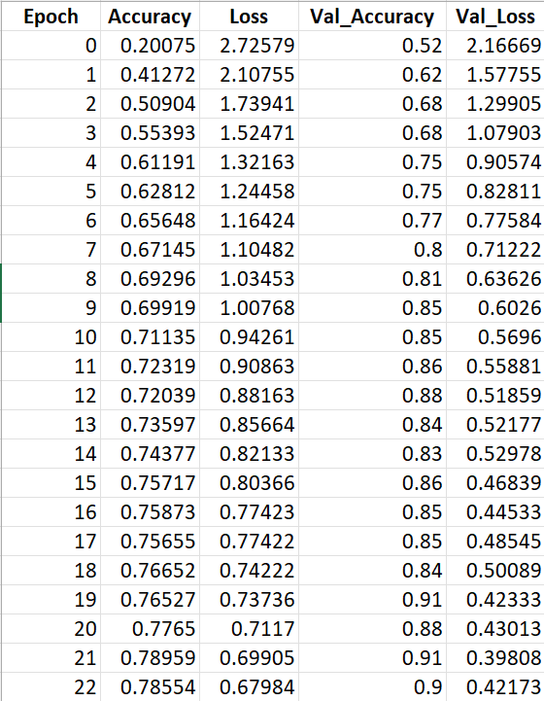
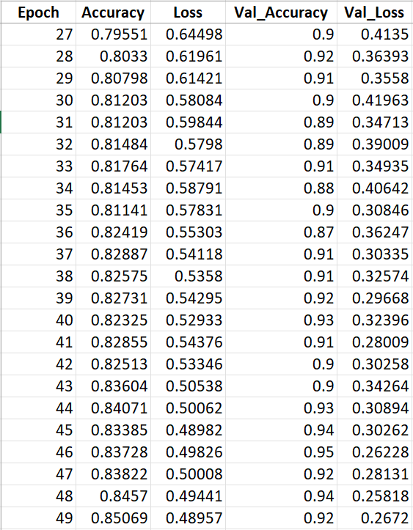
History
…
At Epoch 50 (index 49): Accuracy = 85.069% and Val_Accuracy = 92%

Slide 8
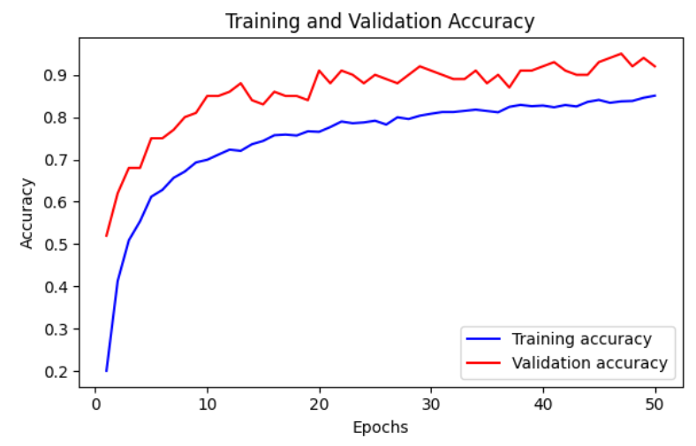
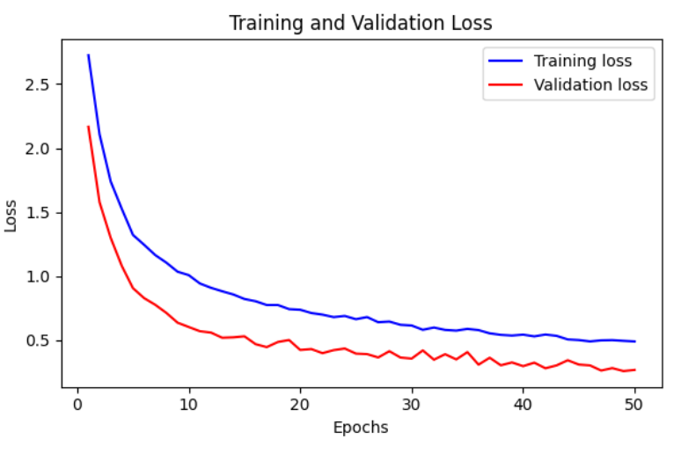
Plot History

Slide 9
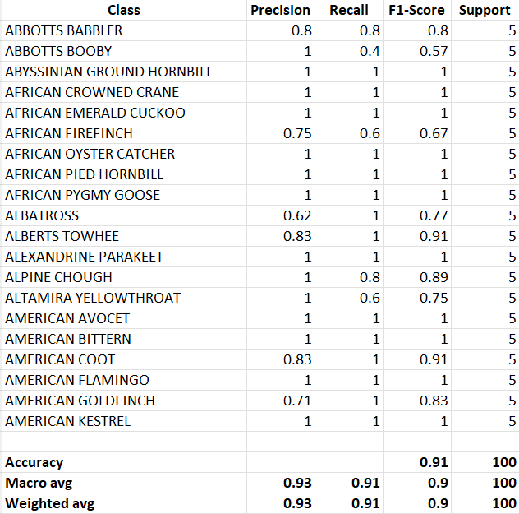
Test Accuracy and Classification Report
The Test Accuracy was 91%.
Classification Report Accuracy displayed as 91%.

Slide 10
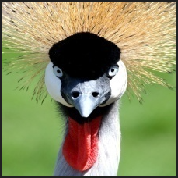
Prediction
Image used for prediction from ‘images to predict folder’: ‘2.jpg’
Prediction Result:
The predicted bird species was the AFRICAN CROWNED CRANE.

Slide 11
End
Thank you

